Slide 1
VPN
Virtual Private Network

Slide 2




MEET OUR TEAM
Mossaddak Hossain
Shariar Kabir
Md.Mustakim
Reduan Shariar
191-15-2413
191-15-2414
Chief Operations Officer
VP Marketing

Slide 3
Content
Introduction
Working Procedure
Types
Necessity
Disadvantages
Summary

Slide 4
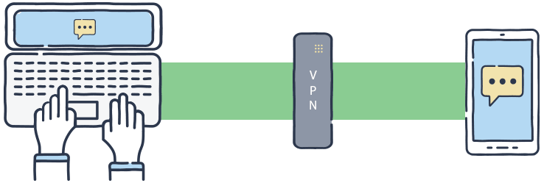

INTRODUCTION
VPN provides secure network between internet & user. It disguises IP address when user use internet, making its location invisible to everyone. Via VPN all data traffic is routed through an encrypted virtual tunnel.

Slide 5

How a vpn works?
Data is transmitted from client machine to a point in VPN network. The VPN point encrypts data and sends it through the internet. Another point in user’s VPN network decrypts user data and sends it to the appropriate internet resource, such as a web server, an email server, or user company's intranet.

Slide 6

Types of vpn:
There are five types of VPN:
PPTP
L2TP
OpenVPN
SSTP
IKEv2

Slide 7
PPTP: PPTP stands for Point-to-Point Tunneling Protocol, and it's a VPN protocol that was introduced back in 1995, though it was in development ten years prior to that date
L2TP : Layer 2 Tunneling Protocol (or L2TP) is a tunneling protocol used by both VPNs and internet service providers (ISPs). It doesn’t encrypt your content but simply creates a connection between you and a VPN server.
OpenVPN : OpenVPN is both an open-source VPN protocol and VPN software that enables people to run secured VPN connections. Most VPN providers offer this protocol because it's very secure (it uses the OpenSSL library and 256-bit encryption) and it works across multiple platforms.
SSTP : The protocol is designed to secure online data and traffic, and is considered a much safer option for Windows users than PPTP or L2TP/IPSec.
IKEv2 : IKEv2 is both a VPN protocol and an encryption protocol used within the IPSec suite. Essentially, it's used to established and authenticate a secured communication between a VPN client and a VPN server.

Slide 8

WHY vpn?
VPN use is important for online privacy whenever user logging into the internet from a public spot because cyber snoops could track user’s online activity when users are using public Wi-Fi, whether it's on user computer or user mobile device.

Slide 9

Disadvantage of vpn:
Some VPNs may slow connection speed.
Could be blocked from using certain services or websites, like Netflix.
VPNs are illegal or tightly controlled in certain countries, such as China.

Slide 10
SUMMERY
VPN stands for "Virtual Private Network" and describes the opportunity to establish a protected network connection when using public networks. VPNs encrypt your internet traffic and disguise your online identity. This makes it more difficult for third parties to track your activities online and steal data​

Slide 11
THANK YOU

